Slide 1

Introduction to Brachytherapy
RT4220 – Lecture #15
Kedree Proffitt
WSU
11/13/2025

Slide 2
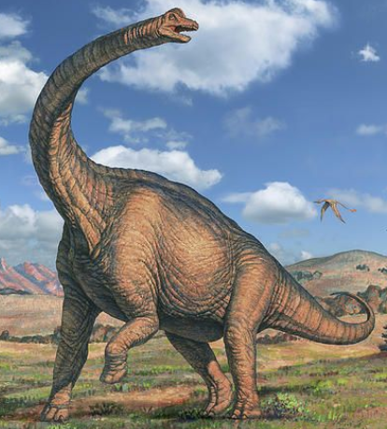
What is Brachytherapy?
“Treatment with radionuclides at short distance”
From latin brachios, meaning short
This is in contrast to external beam therapy, or teletherapy
We can characterize the many modalities of brachytherapy as such:
Method of placing sources
Dose rate
Loading technique

Slide 3
Why is Brachy Used?
High dose to small volume
01
Less dose to superficial tissues
02
Shorter overall treatment time (days)
03
Radiobiological advantages of low dose rate (?)
04

Slide 4
Where Brachy Fails
Radiation exposure to staff, visitors
Invasive procedure
Requires highly skilled operator
Requires hospital admission
Not suitable for large volumes
Precision of placement becomes critical

Slide 5
Categories; by Method
Intracavitary: Applicator in a natural cavity
Gynecological
Interstitial: Needles, catheters, or seeds placed directly in tissue
Prostate, cervix, head and neck, breast, …
Surface: Applicator applied externally
Skin
Intraluminal: Tubes placed in tubular organs
Bronchus, biliary tree, esophagus, arteries

Slide 6
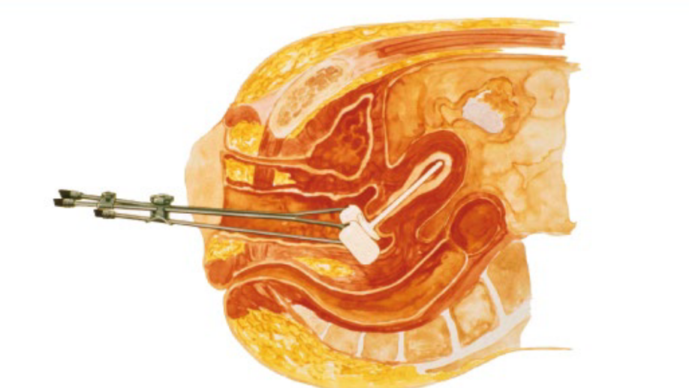
Intracavitary

Slide 7
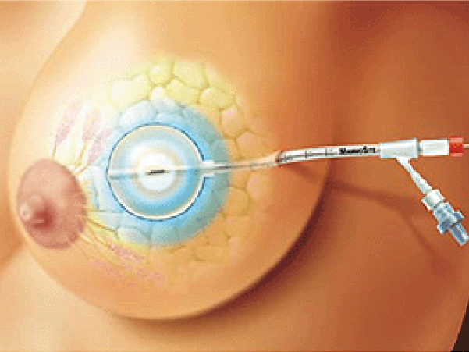
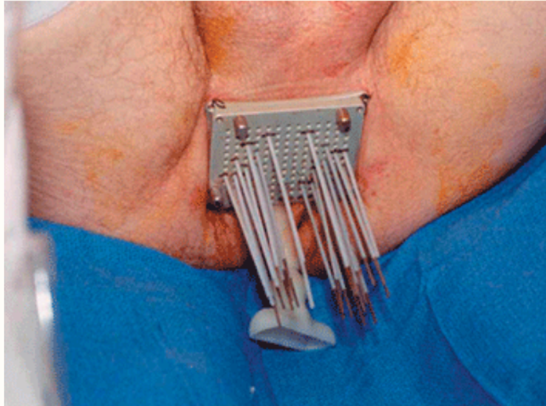
Interstitial

Slide 8
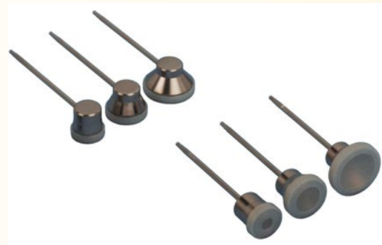
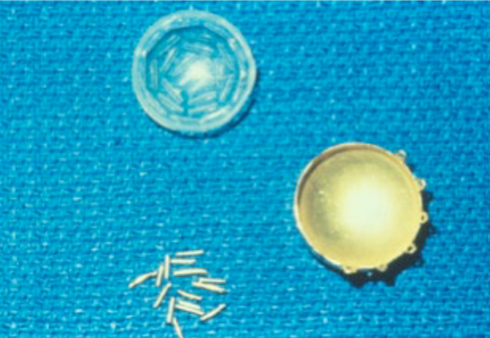
Surface

Slide 9
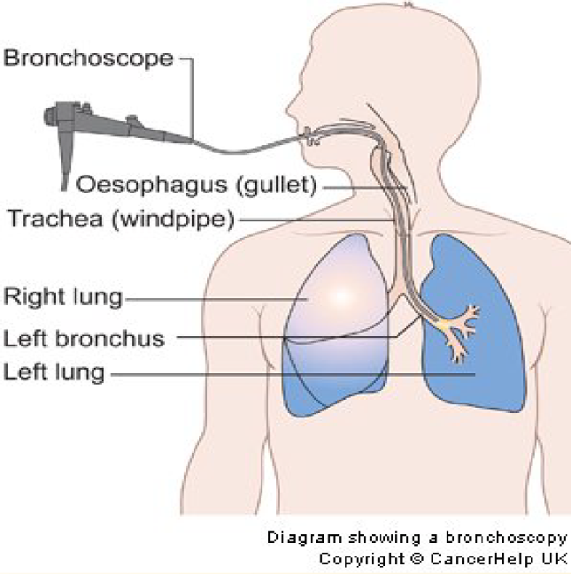
Intraluminal

Slide 10
Categories; By Dose Rate
Permanent: < 20 cGy/hr (natural decay)
Low Dose Rate (LDR): 30-80 cGy/hr (standard)
Medium Dose Rate: 100-1200 cGy/hr (has problems with radiobiology)
High Dose Rate (HDR): >1200 cGy/hr (fractionated)
Pulsed: many small HDR fractions, simulating LDR

Slide 11
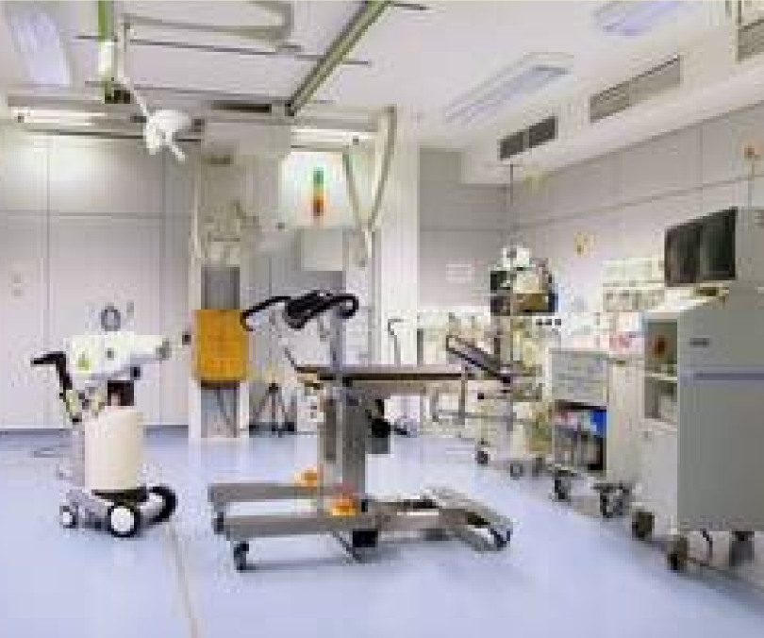
Categories; BY loading Method
Manual: “hot” loading in the OR
Manual Afterloading: unloaded applicator at surgery, sources placed later for continuous treatment
Remote Afterloading: source managed by machine, usually fractionated or interruptible

Slide 12
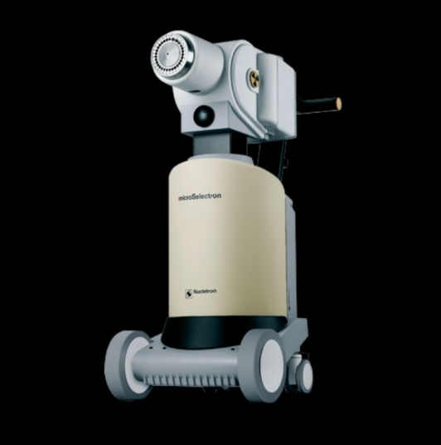

Slide 13
Typical Activities Used
Radioactive Stent: uCi range
Permanent I-125: 0.4 mCi/seed, to 30 mCi
Temporary GYN: 25 mCi/source, to 200 mCi
Temporary Template: 3 mCi/seed, to 400 mCi
HDR: 10 Ci

Slide 14
Types of Sources
Needles
Tubes
Wire
Seeds
Ribbons
Plaques
Pellets
Cable-mounted

Slide 15
Important Fundamental Characteristics
Half-life
Mean Energy
HVL, TVL
Exposure Rate Constant ($Γ$)
Exposure Rate Constant (Γ)

Slide 16
Review of Fundamentals
GET PHYSICSED! :o

Slide 17
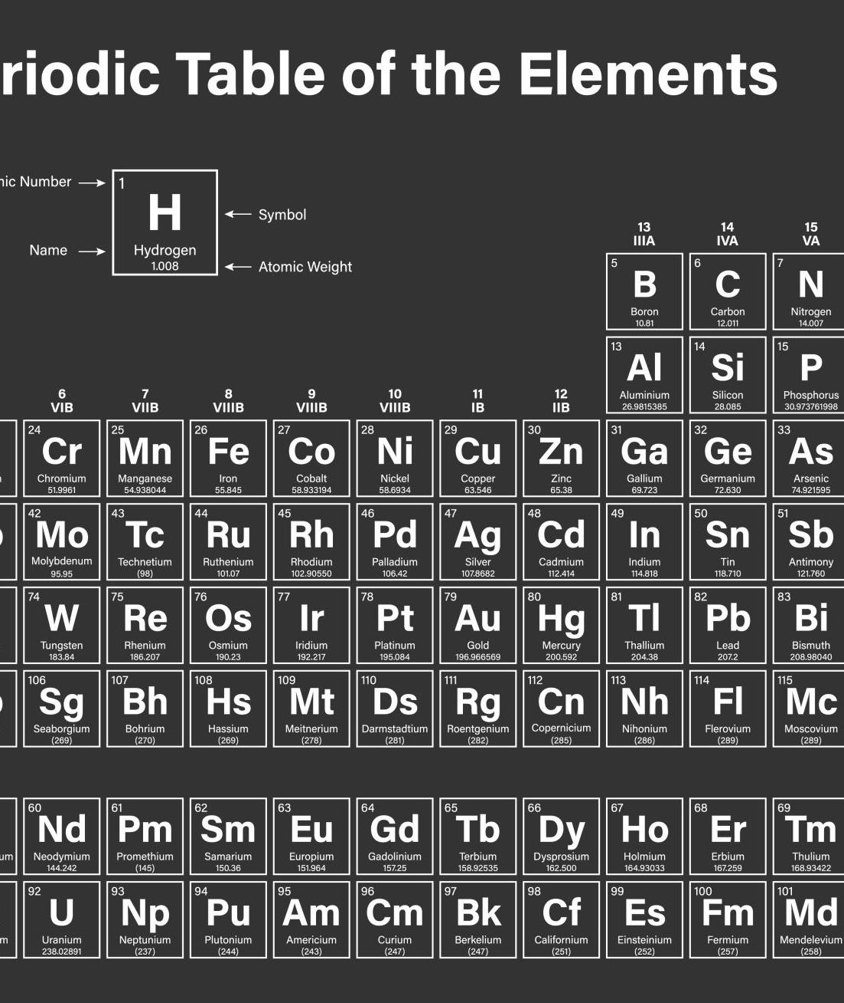
Mean Energy
Photon emitting isotopes can be grouped into two categories:
High Energy: >100 keV, similar to Radium in tissue, thus they have similar character in tissue, vary only in shielding characteristics
Low Energy: <50 keV, isotopes like I-125 and Pd-103

Slide 18

Exposure Rate Constant ($Γ$)
Relates contained activity to an output
May describe exposure or air kerma
Source of error in traditional systems
Not used today to calculate dose, but physics still learns it

Slide 19
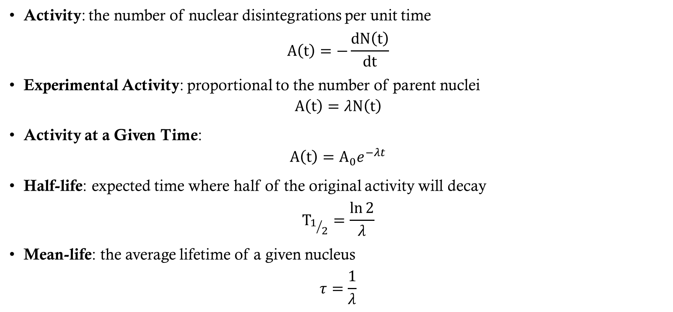
Radioactive Decay and Activity
Activity: the number of nuclear disintegrations per unit time
$$A\left(t\right)=−\frac{dN\left(t\right)}{dt}$$
Experimental Activity: proportional to the number of parent nuclei
$$A\left(t\right)=λN\left(t\right)$$
Activity at a Given Time:
$$A\left(t\right)=A_{0}e^{−λt}$$
Half-life: expected time where half of the original activity will decay
$$T_{1/2}=\frac{\ln{2}}{λ}$$
Mean-life: the average lifetime of a given nucleus
$$τ=\frac{1}{λ}$$

Slide 20
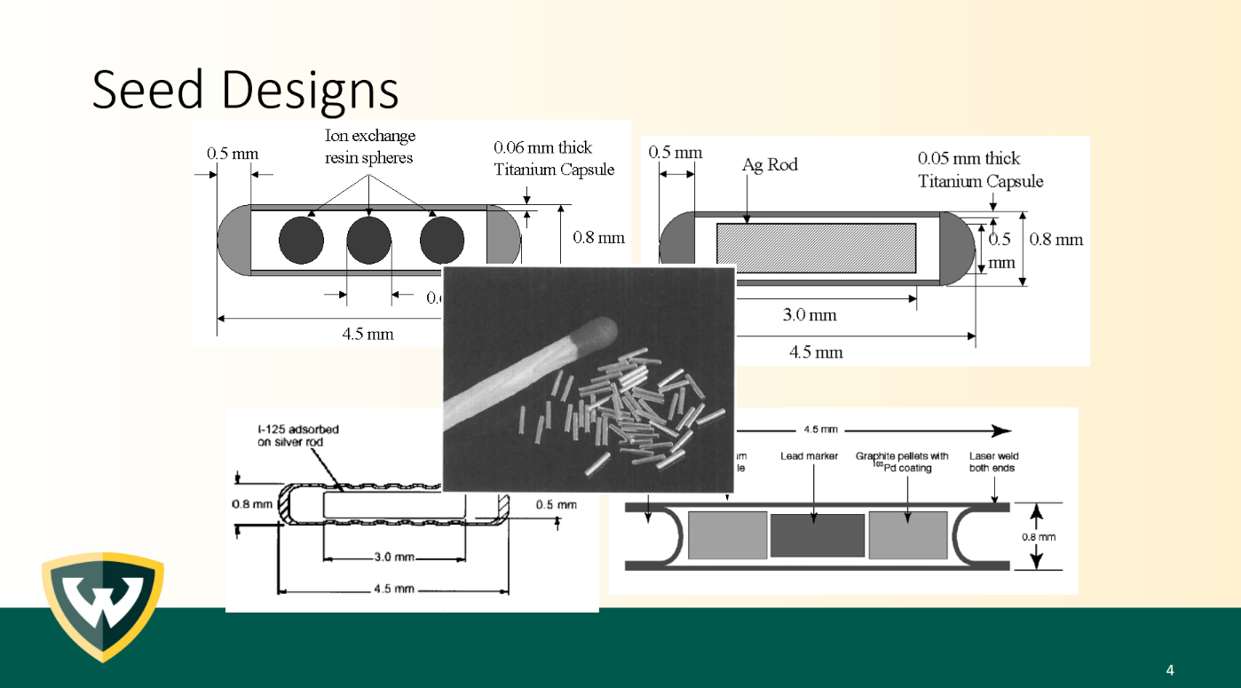

Slide 21
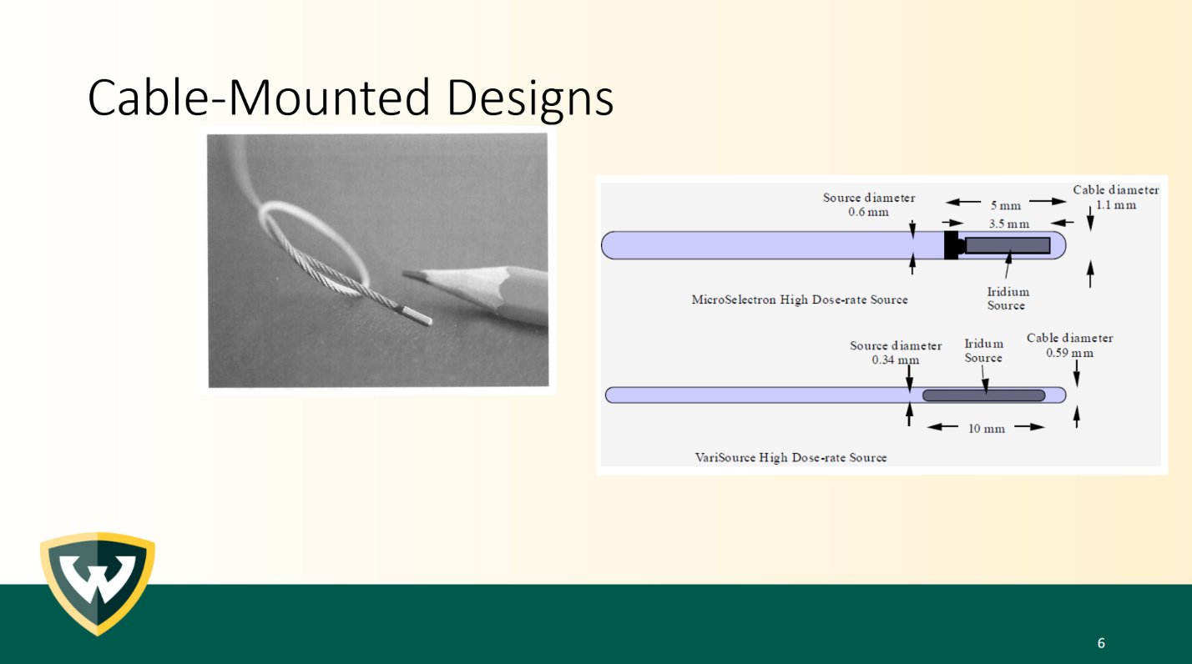

Slide 22
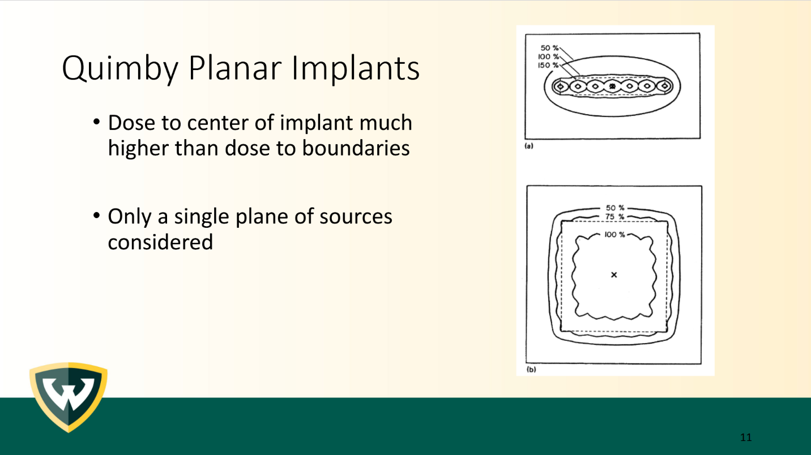

Slide 23
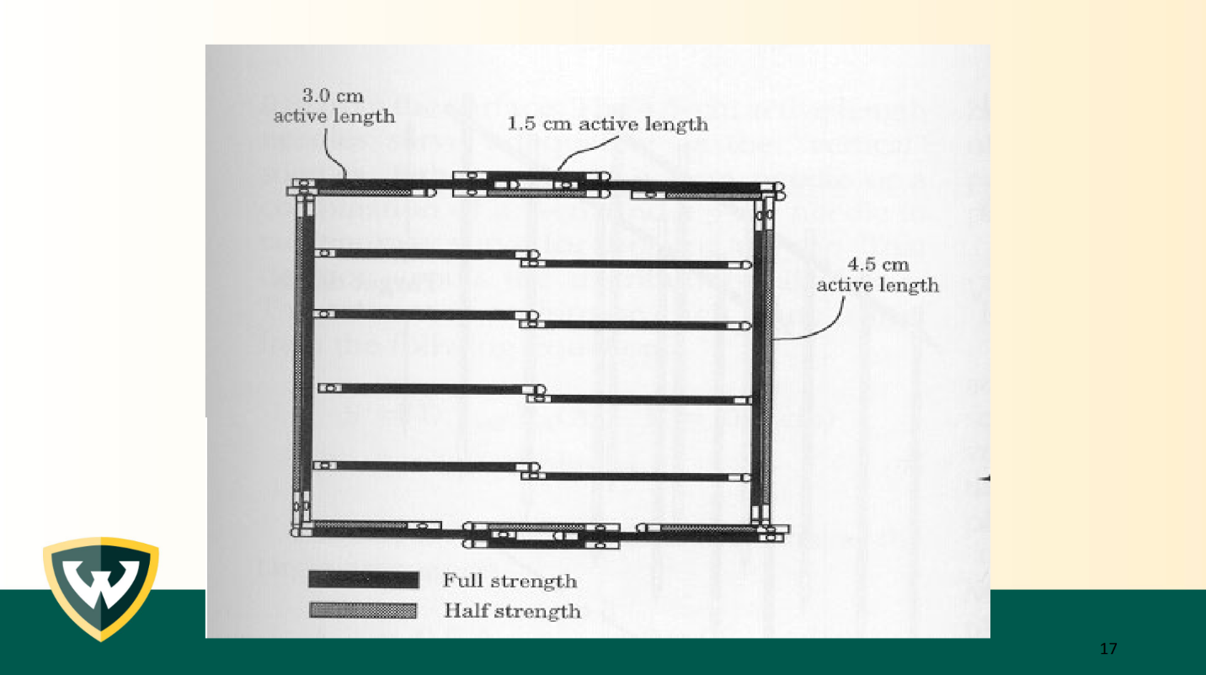

Slide 24
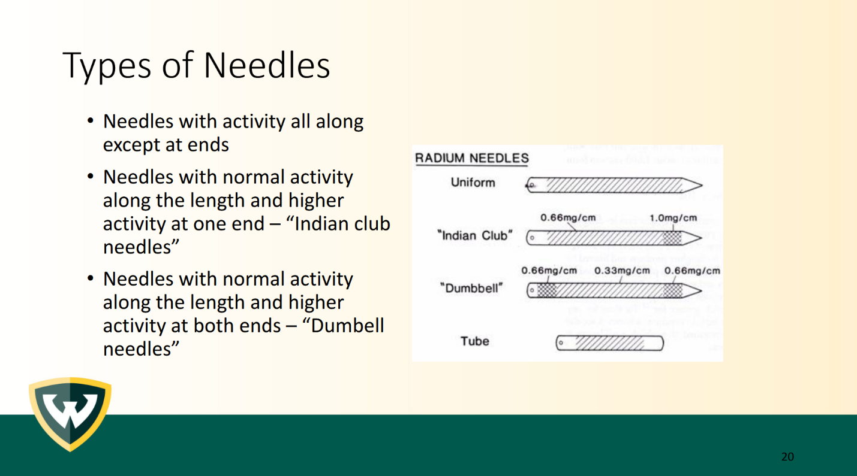

Slide 25
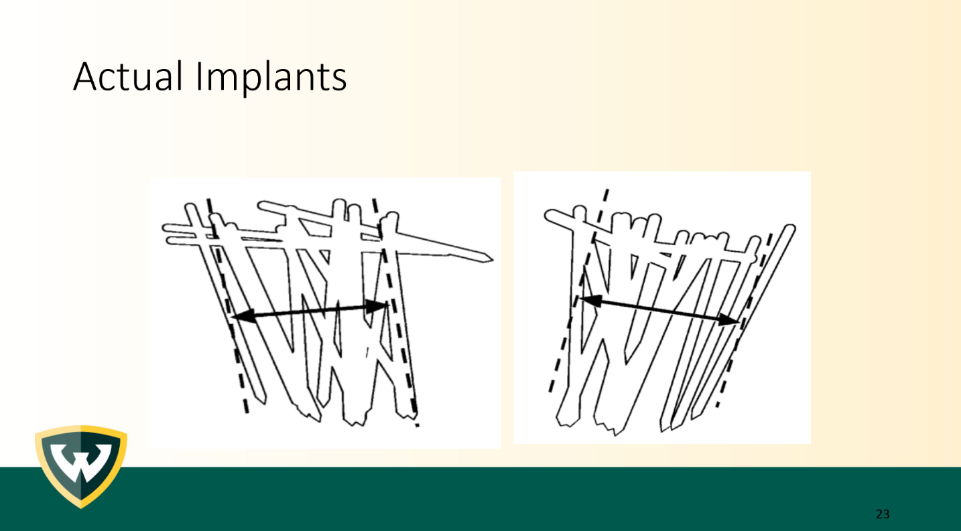

Slide 26

Load Up Brachytherapy Quality Assurance!
By Dr. Adrian Nalichowski

